Slide 1
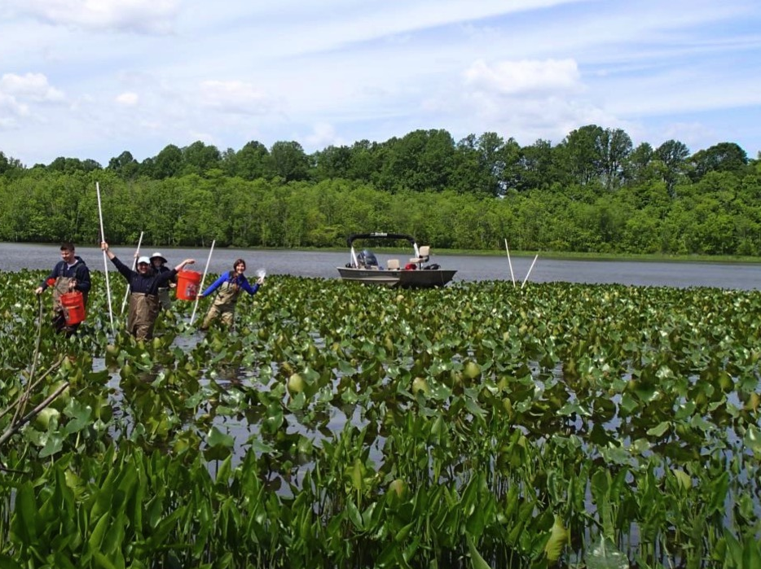
Urbanization and microbial communities
in freshwater tidal wetlands
Martina Gonzalez Mateu BIOL709B

Slide 2
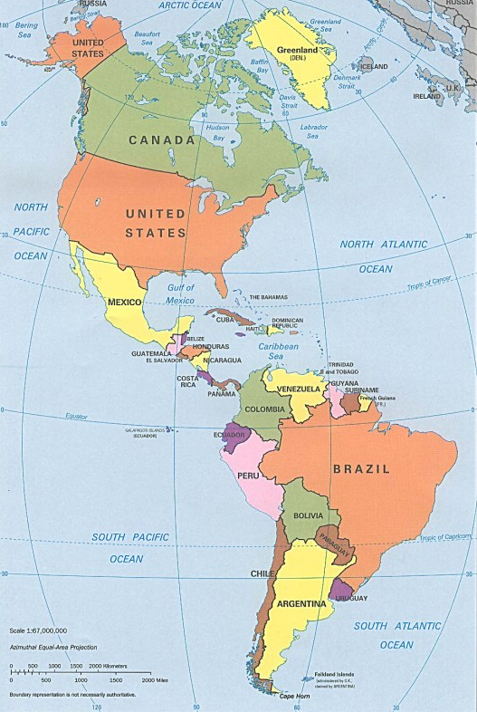
Comparing wetland microbes
Microbes are central to nutrient transformations
Improving water quality
Assisting in plant productivity
We want to compare microbes between:
Urban vs. Rural watersheds
Two different plant types
Two different cites, but at similar latitudes
DC (38.9°)
BA (-35°)

Slide 3
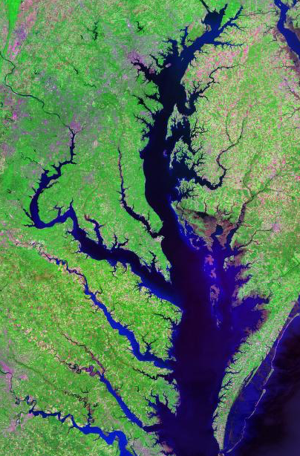
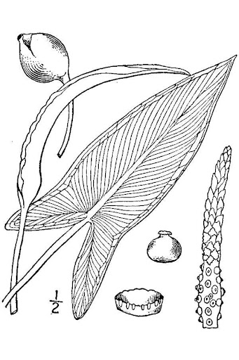
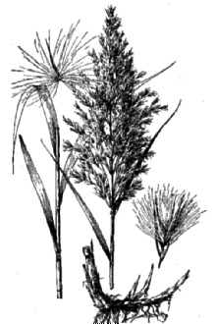
Chesapeake Bay
Anacostia River
Urban
Patuxent River
Choptank River
Rural
Peltandra virginica
Phragmites australis

Slide 4
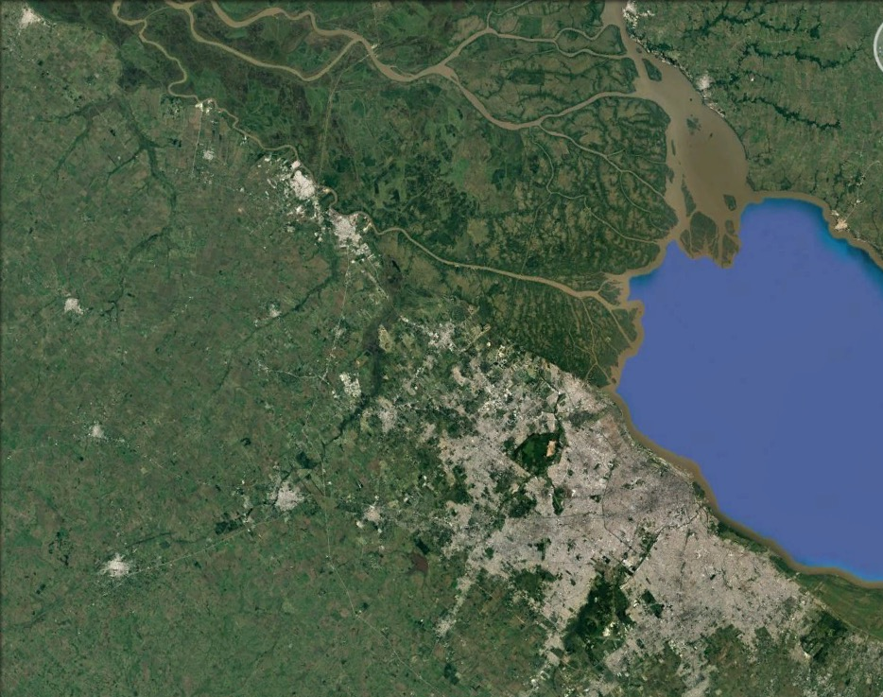
Overview of the Argentina site
Paraná River Delta
Sampling sites
Rio de la Plata Estuary
City of Buenos Aires

Slide 5
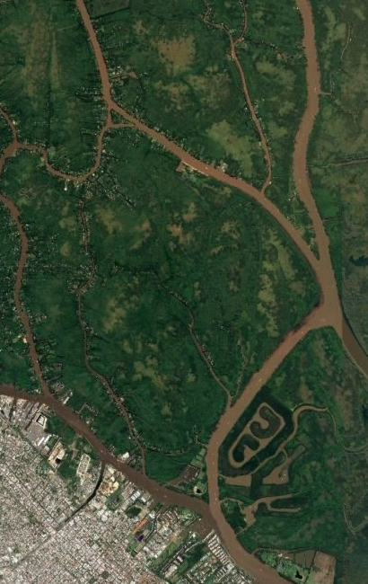
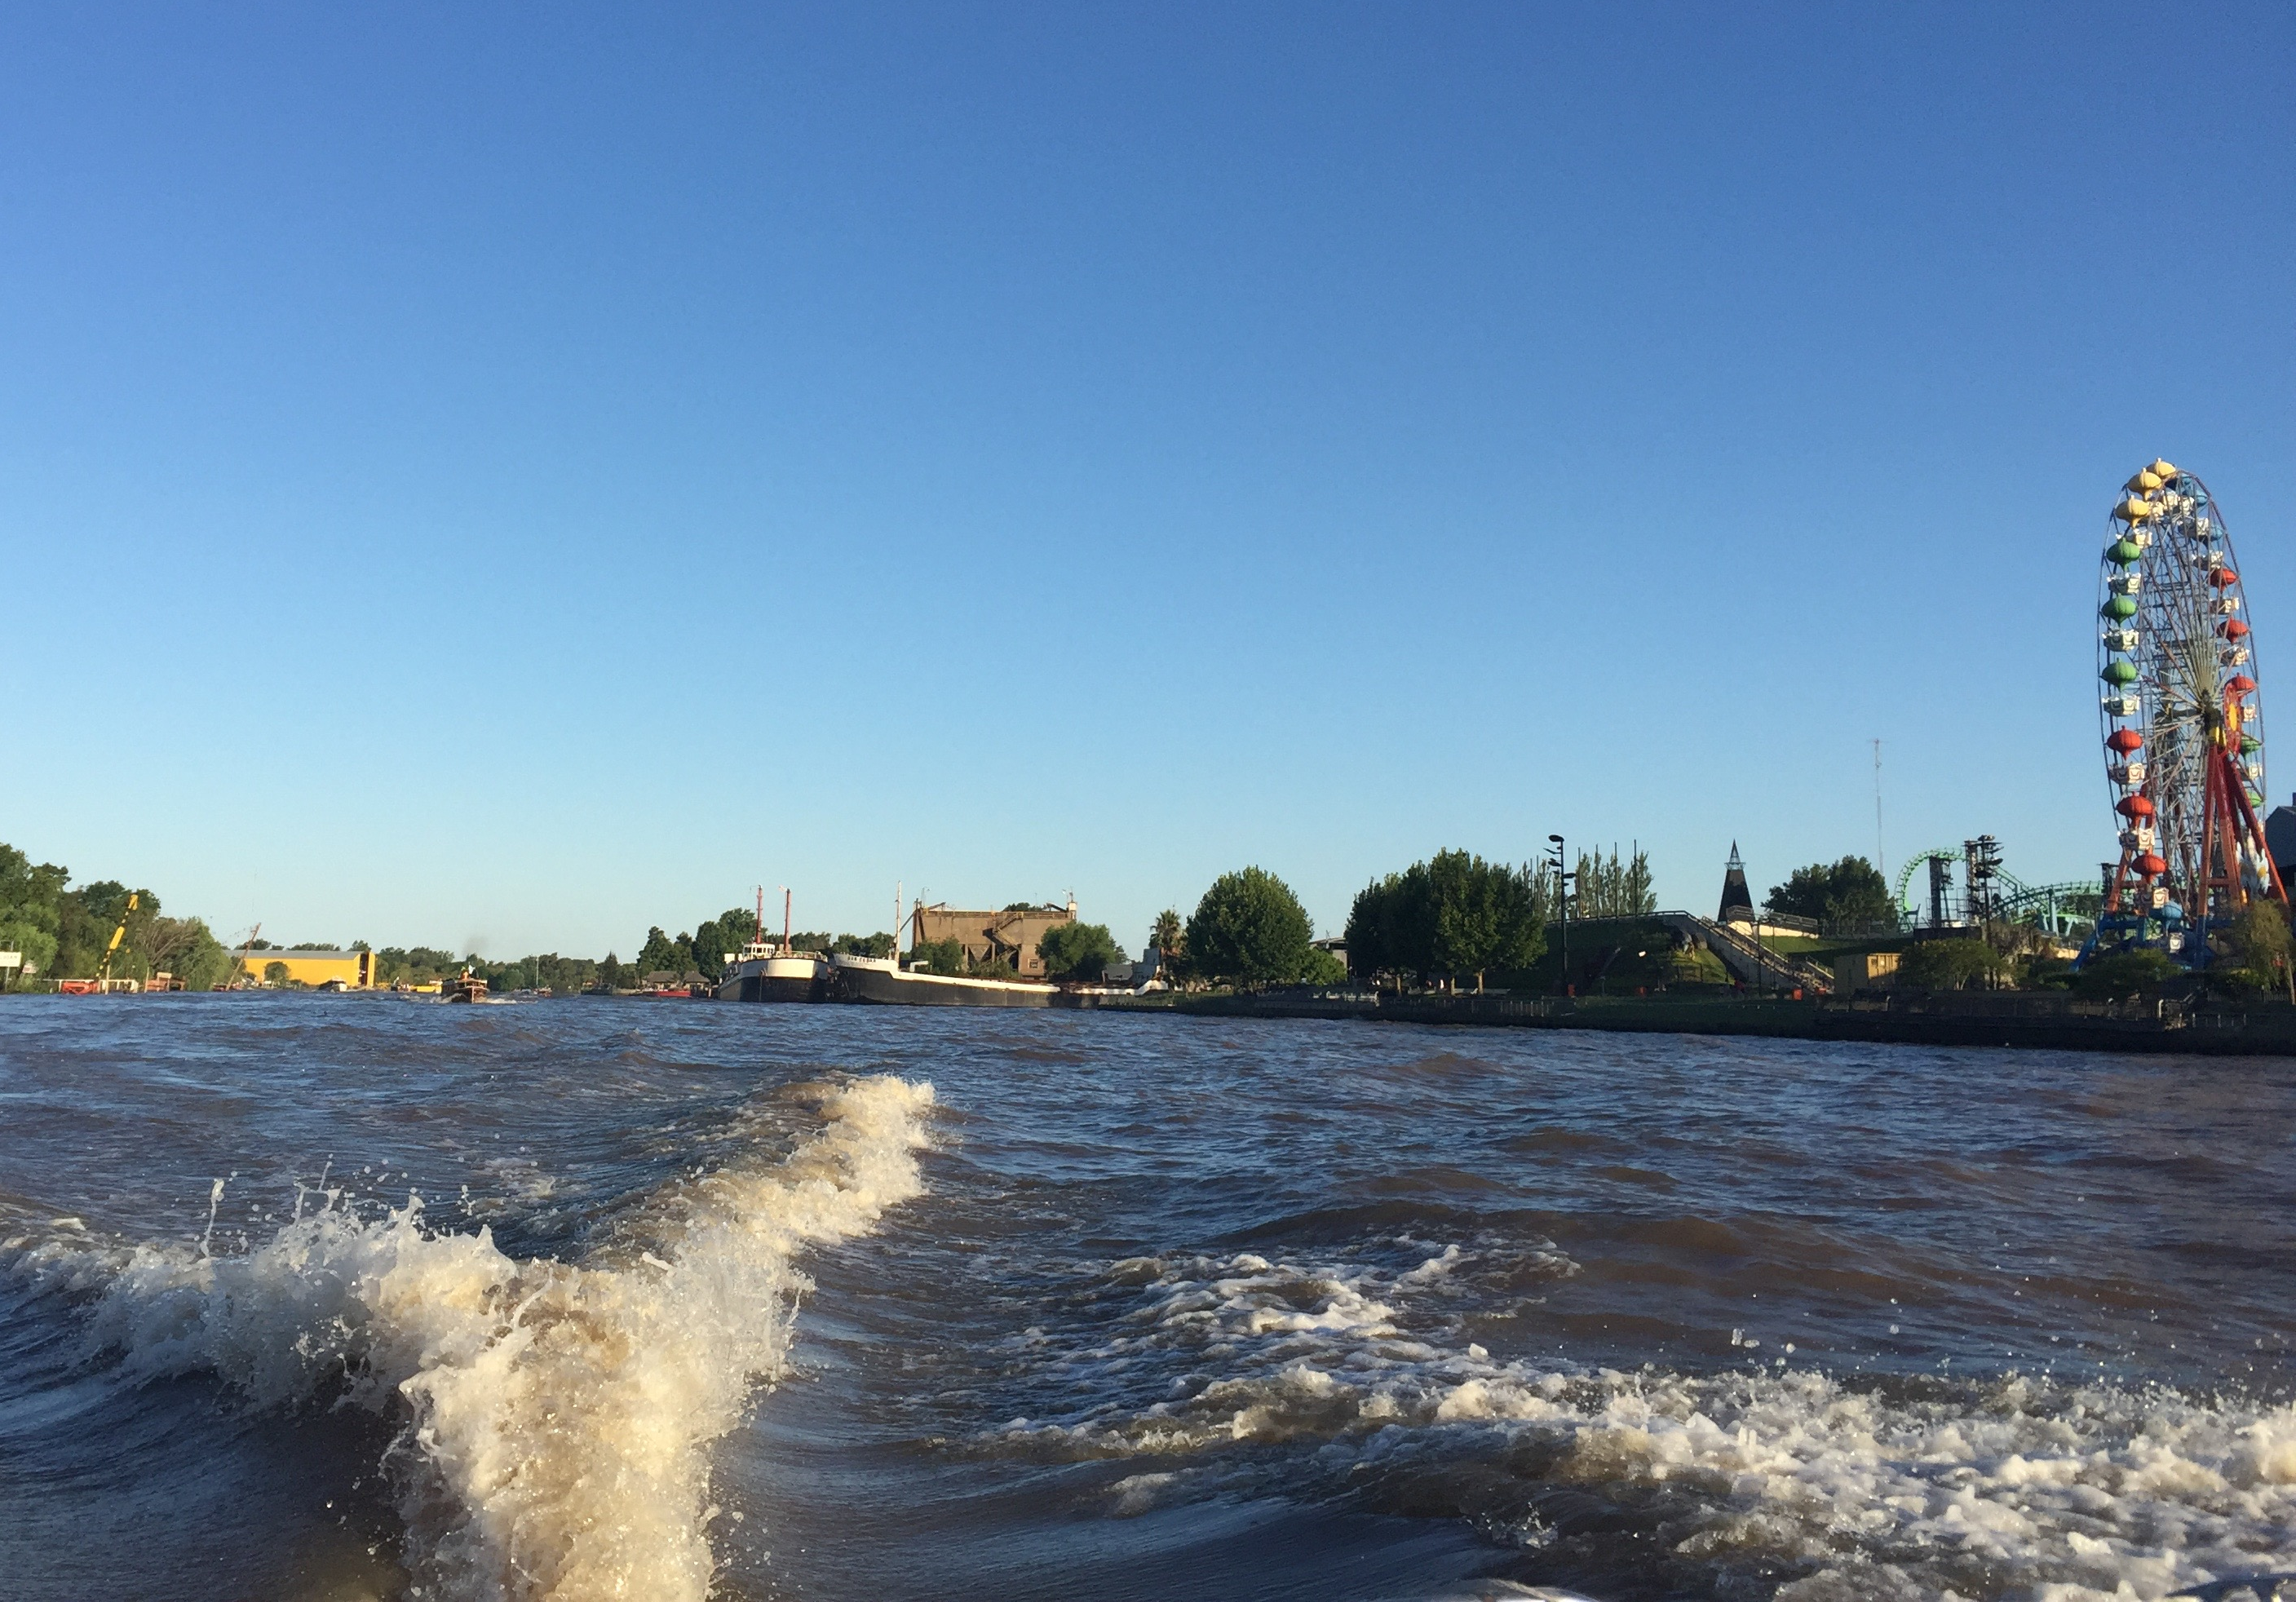
Delta of the Paraná River
Luján River
Urban
Sarmiento River
Unión River
Rural

Slide 6
Wetland
Plant type
Rhizosphere soil
Plant with rhizome
3 samples
Region
Urban
3 samples
Plant without rhizome
Plant with rhizome
3 samples
Maryland
Suburban
Plant without rhizome
3 samples
Plant with rhizome
3 samples
Rural
Plant without rhizome
3 samples
Plant with rhizome
3 samples
Urban
Plant without rhizome
3 samples
Buenos Aires
Plant with rhizome
3 samples
Suburban
Plant without rhizome
3 samples
Plant with rhizome
3 samples
Rural
Plant without rhizome
3 samples

Slide 7
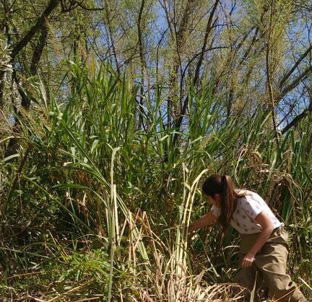
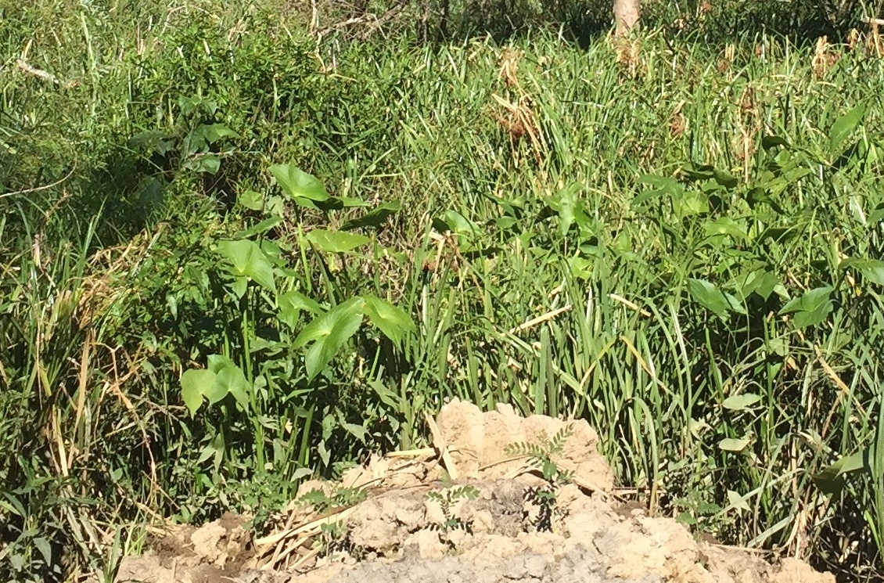
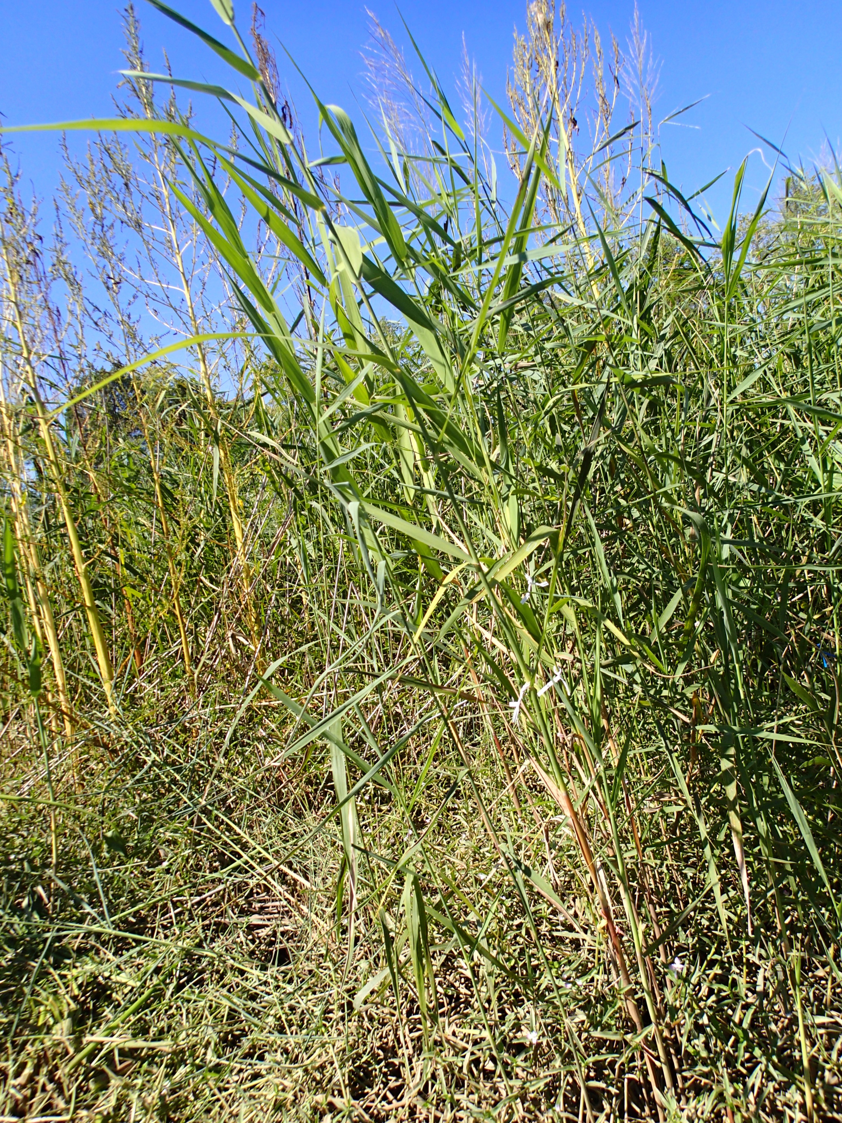
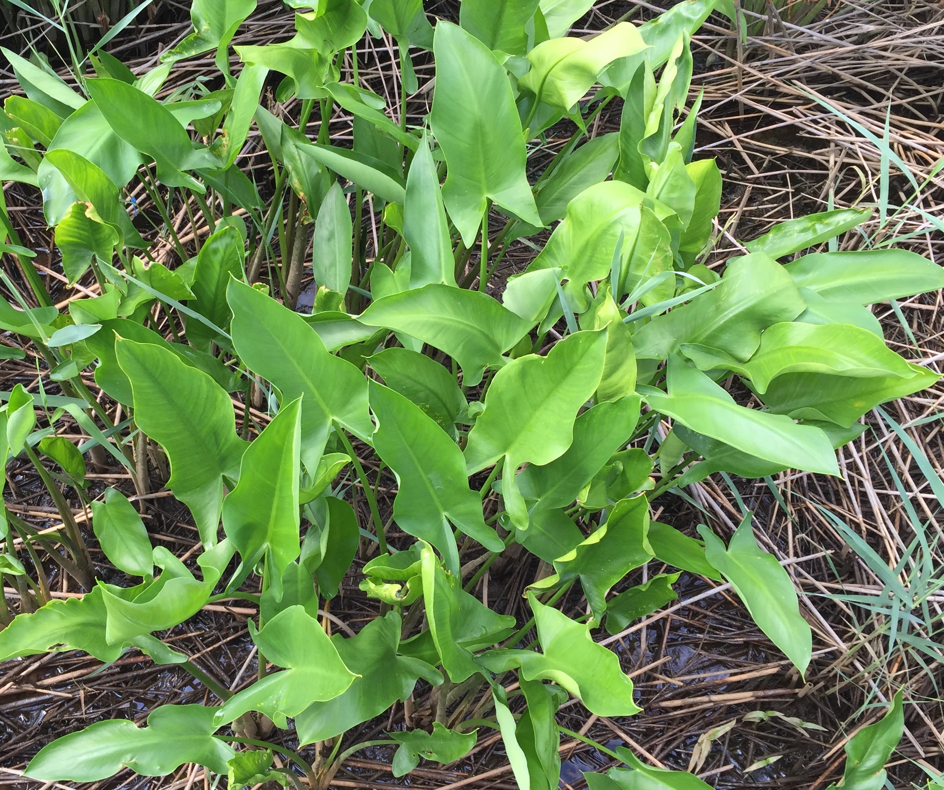
Hymenachne grumosa
Sagittaria montevidensis
Soil samples
pH
Texture
Organic matter
Total C
Total N
Peltandra virginica
Phragmites australis

Slide 8
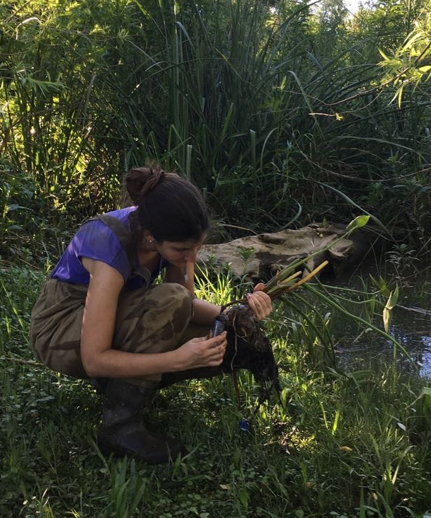
Biological questions
Are microbial communities different across wetland types and between plant species?
Are the microbial communities similar between regions based on urbanization level?
What soil parameters are relevant in determining microbial community composition in these wetlands?

Slide 9
Workflow
Sequencing
QIIME
Join pair-end sequences
Demultiplex and check quality of samples
Combine individual split library sequence outputs
OTU picking
Assign taxonomy
Check sampling depth and rarefy data set if needed
QIIME
Community composition for each wetland and plant species
OTU table
R
Richness
Beta diversity
Correlation between microbial and soil variables
Functional group analysis?
Soil analysis
R

